Slide 1
Cryptography - Dr Gopal Singh Rawat

Slide 2
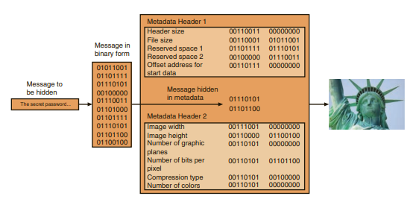
Cryptography
practice of transforming information so that it is secure and cannot be accessed by unauthorized parties
steganography hides the existence of the data

Slide 3
Cryptography
the process of changing the original text into a scrambled message is known as encryption
the reverse process is decryption, or changing the message back to its original form
Plaintext. Unencrypted data that is input for encryption or is the output of decryption is called plaintext.
Ciphertext. Ciphertext is the scrambled and unreadable output of encryption.
Cleartext. Readable (unencrypted) data that is transmitted or stored in “the clear” and is not intended to be encrypted is called cleartext

Slide 4
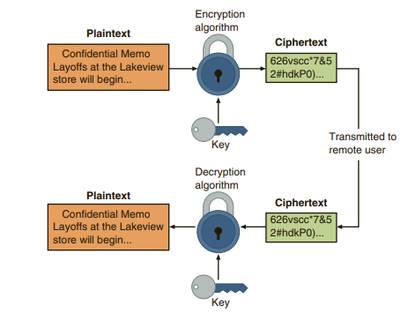
Cryptographic process

Slide 5
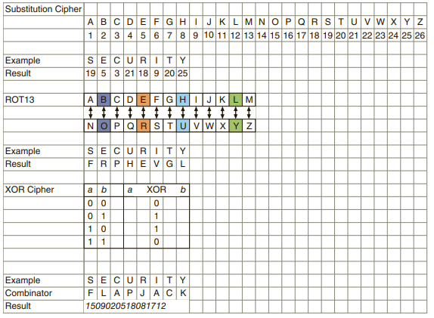
Cryptographic algorithms

Slide 6
Cryptoanalysis
statistical analysis on the ciphertext to discover the underlying key to the cryptographic algorithm
Diffusion: means that if a single character of plaintext is changed then it should result in multiple characters of the ciphertext changing
Confusion: means that the key does not relate in a simple way to the ciphertext. Each character of the ciphertext should depend upon several different parts of the key

Slide 7
Cryptography and Security
Confidentiality
Integrity
Authentication
Non-repudiation
Obfuscation

Slide 8
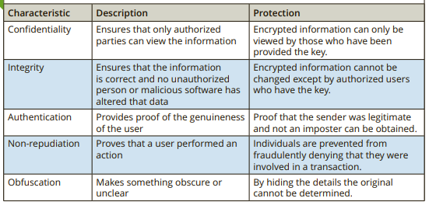
Cryptography and Security

Slide 9
Cryptographic algorithms
stream cipher: one character and replace it with one character
Example: RC4, PANAMA
block cipher: manipulates an entire block of plaintext at one time
Example: Advanced Encryption Standard(AES), Data Encryption Standard(DES)

Slide 10
Cryptographic algorithms
Hash Algorithms
symmetric cryptographic algorithms
asymmetric cryptographic algorithms

Slide 11
Hash Algorithms
one-way hash algorithm
creates a unique “digital fingerprint” of a set of data
process is called hashing
the resulting fingerprint is a digest (sometimes called a message digest or hash)
purpose is not to create ciphertext that can later be decrypted
used primarily for comparison purposes

Slide 12
Hash Function
a hash function accepts a variable-size message M as input and produces a fixed size output
hash code H(M)
Other names: message digest or hash value
error-detection capability: change to any bit or bits in the message results in a change to the hash code

Slide 13
Hash Function: Properties
H can be applied to a block of data of any size
H produces a fixed-length output
H(x) is relatively easy to compute for any given x, making both hardware and software implementations practical

Slide 14
Hash Function: Properties
For any given value h, it is computationally infeasible to find x such that H(x) = h (one-way property)
For any given block x, it is computationally infeasible to find y != x such that H(y) = H(x) (weak collision resistance)
It is computationally infeasible to find any pair (x, y) such that H(x) = H(y) (strong collision resistance)

Slide 15
Hash Function: Examples
Message Digest (MD)
Secure Hash Algorithm (SHA)
RACE Integrity Primitives Evaluation Message Digest
Hashed Message Authentication Code (HMAC)

Slide 16
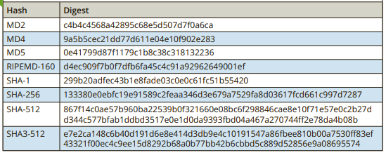
Hash Function: Examples
Plaintext: CengageLearning
Generate All Hashes - MD5, SHA1, SHA3, CRC32 - Online - Browserling Web Developer Tools

Slide 17
Symmetric Cryptographic Algorithms
same single key to encrypt and decrypt a document
symmetric algorithms are designed to encrypt and decrypt the ciphertext
Symmetric cryptography can provide strong protections against attacks if the key is kept secure
Data Encryption Standard (DES)
Triple Data Encryption Standard(3-DES)
Advanced Encryption Standard(AES)
Rivest Cipher (RC)

Slide 18
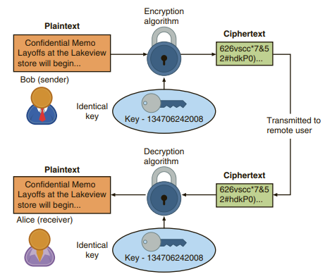
Symmetric Cryptographic Algorithms

Slide 19
Asymmetric Cryptographic Algorithm
Distributing and maintaining a secure single key among multiple users, who are often scattered geographically, poses significant challenges
Asymmetric encryption uses two keys instead of only one
these keys are mathematically related and are called the public key and the private key.
public key is known to everyone and can be freely distributed
private key is known only to the individual to whom it belongs
RSA, Elliptic Curve Cryptography, Digital Signature Algorithm(DSA)

Slide 20
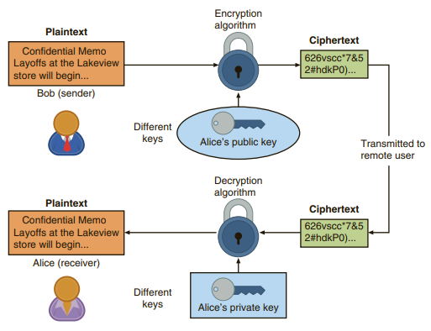
Asymmetric Cryptographic Algorithm

Slide 21
Symmetric vs Asymmetric
Symmetric Key Encryption | Asymmetric Key Encryption
It only requires a single key for both encryption and decryption. | It requires two keys, a public key and a private key, one to encrypt and the other one to decrypt.
The size of cipher text is the same or smaller than the original plain text. | The size of cipher text is the same or larger than the original plain text.
The encryption process is very fast. | The encryption process is slow.
It is used when a large amount of data is required to transfer. | It is used to transfer small amounts of data.
It only provides confidentiality. | It provides confidentiality, authenticity, and non-repudiation.
It is efficient as it is used for handling large amount of data. | It is comparatively less efficient as it can handle a small amount of data.

Slide 22



Asymmetric algorithm: RSA
RSA stands for the last names of its three developers, Ron Rivest, Adi Shamir, and Leonard Adleman
RSA algorithm multiplies two large prime numbers p and q
compute their product ( n = pq)
number e is chosen that is less than n and a prime factor to (p–1)(q–1)
number d is determined, so that (ed–1) is divisible by (p–1)(q–1)
values of e and d are the public and private exponents
public key is the pair (n,e)
private key is (n,d)

Slide 23
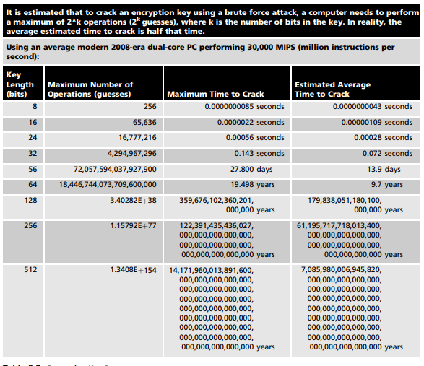

Slide 24
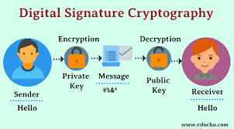
Digital Signature
A digital signature can:
Verify the sender
Prevent the sender from disowning the message(nonrepudiation)
Prove the integrity of the message

Slide 25
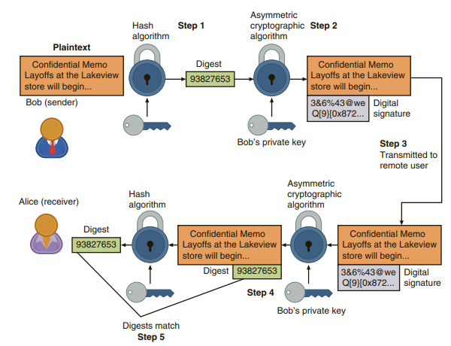
Digital Signature
Public

Slide 26
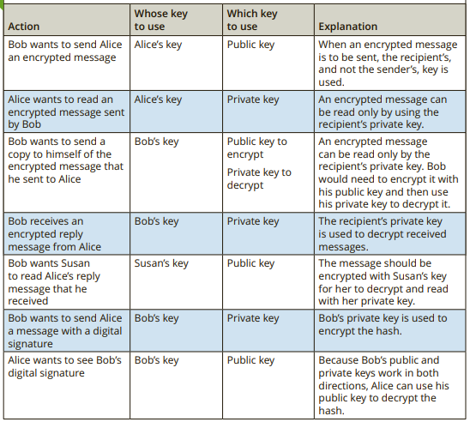
Practices followed

Slide 27
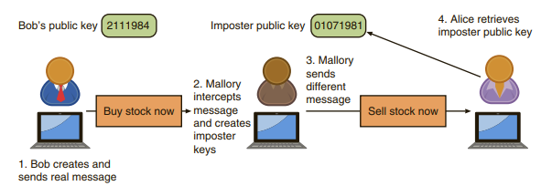
Digital Certificates
weakness with digital signatures: they do not confirm the true identity of the sender

Slide 28
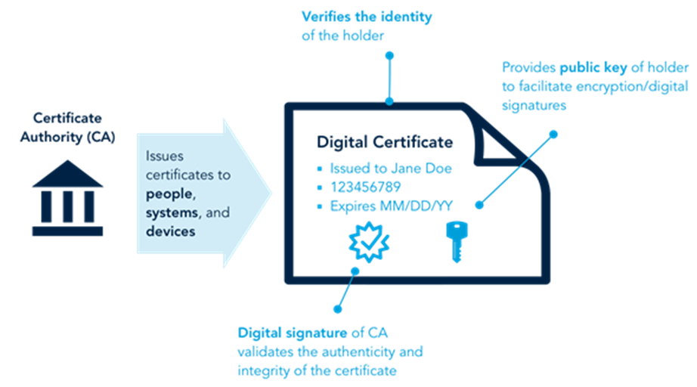
Digital Certificates

Slide 29
Digital Certificates
A digital certificate is a technology used to associate a user’s identity to a public key and that has been digitally signed by a trusted third party
 | Digital Signature | Digital Certificate
Basics / Definition | Digital signature is like a fingerprint or an attachment to a digital document that ensures its authenticity and integrity. | Digital certificate is a file that ensures holder’s identity and provides security.
Process / Steps | Hashed value of original message is encrypted with sender’s secret key to generate the digital signature. | It is generated by CA (Certifying Authority) that involves four steps: Key Generation, Registration, Verification, Creation.
Security Services | Authenticity of Sender, integrity of the document and non-repudiation. | It provides security and authenticity of certificate holder.
Standard | It follows Digital Signature Standard (DSS). | It follows X.509 Standard Format
Digital Signature vs Digital Certificate | Top 10 Differences (educba.com)

